Slide 1
E-COMMERCE BOOKSTORE
BRAN CAMELIA ALEXANDRA

Slide 2
Technologies Used:
FRONT-END:
HTML
CSS
JAVASCRIPT
THYMELEAF
BOOTSTRAP

Slide 3
Technologies Used:
2.BACKEND:
SPRING BOOT
SPRING DATA
SPRING SECURITY
MySQL

Slide 4

Project Description
E-commerce is a business model that lets firms and individuals buy and sell things over the internet.

Slide 5
Project Description – Modules
User signup and login
User profile management
Product management
Shopping cart
Order check-out and order history

Slide 6
Arhitecture
From the architecture perspective, the system is divided into two parts - Bookstore and AdminPortal. Bookstore is the front-end website that customer will be using for submitting orders while AdminPortal is used for administration purpose.

Slide 7
Bookstore - My account module
My account
Guest
Login
User
Profile
Create account
Billing
Order history
Shipping

Slide 8
Bookstore – Browse Book
Booklist
Search
By category
By keywords
View book detail
Add book to shopping cart
Show book availability

Slide 9
Admin Portal
BookList
Book
Add book
Update book
Delete Book

Slide 10
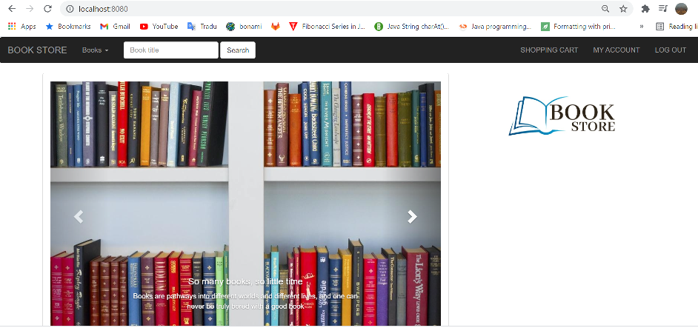
User interface

Slide 11
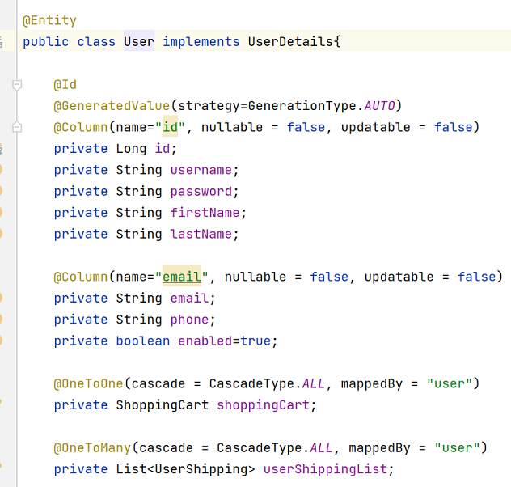
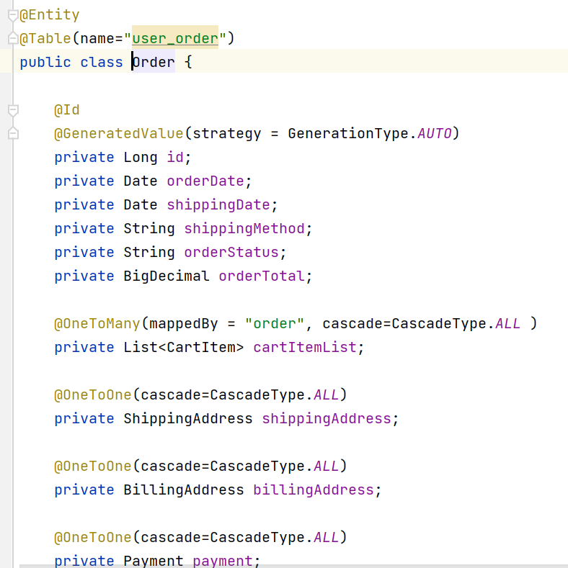
User Entity Order Entity

Slide 12
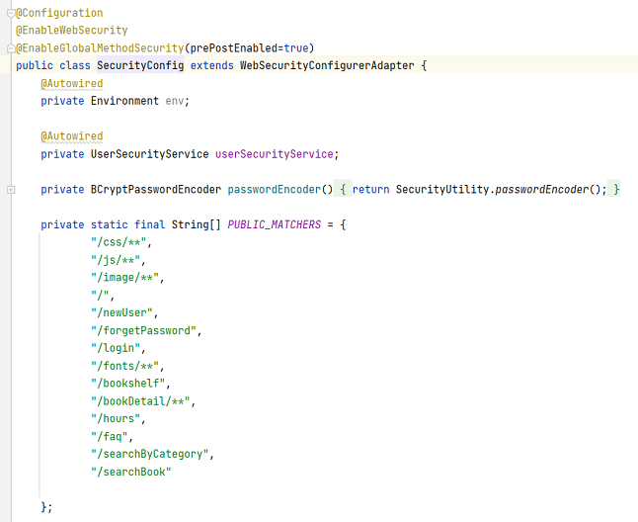
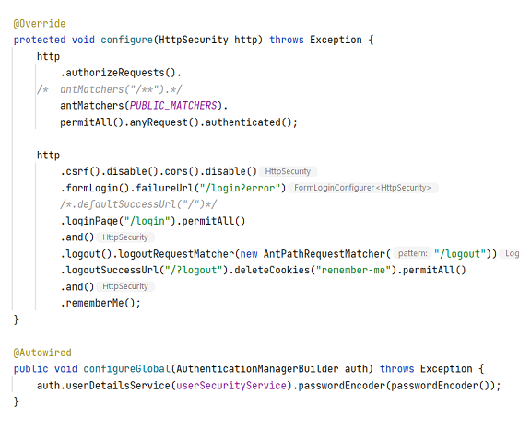
Security config

Slide 13
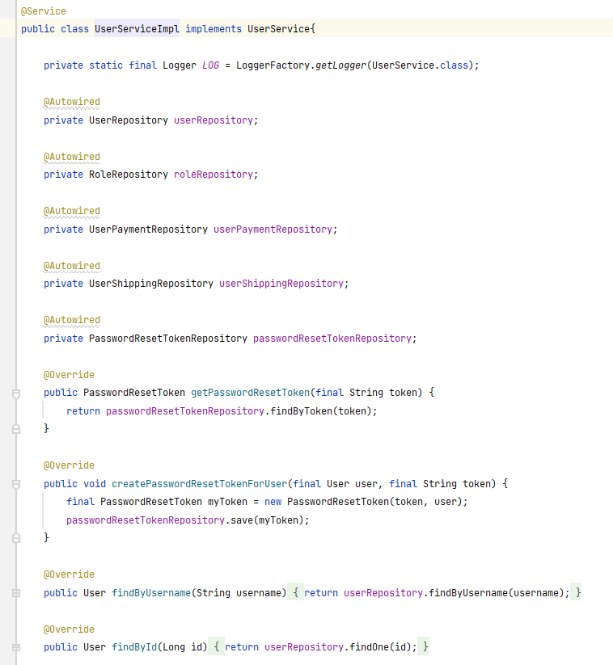
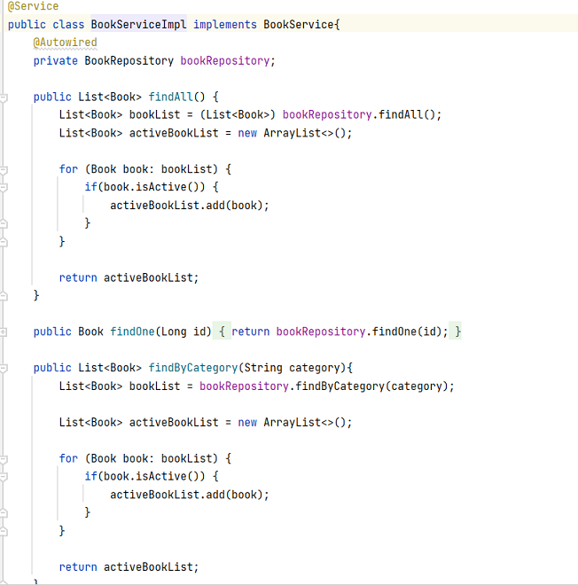
BookService UserService

Slide 14
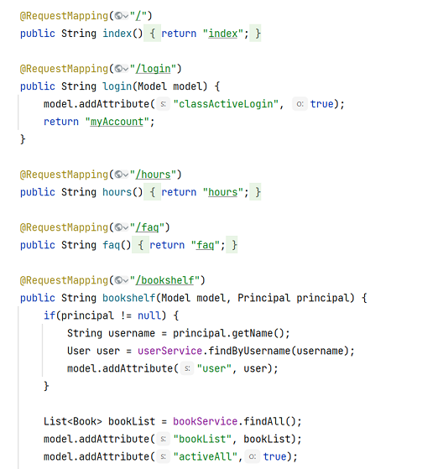
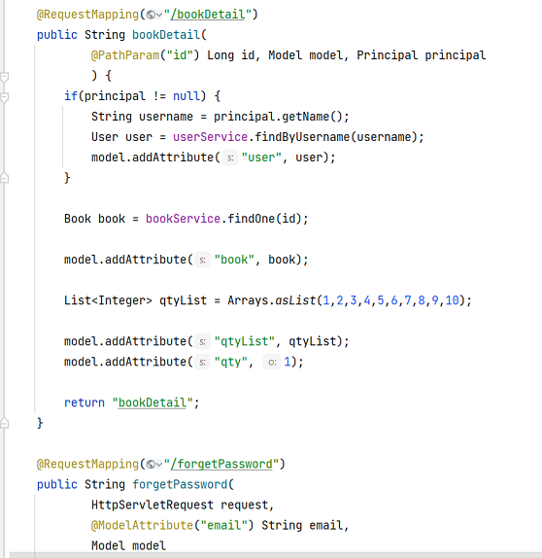
HomeController

Slide 15
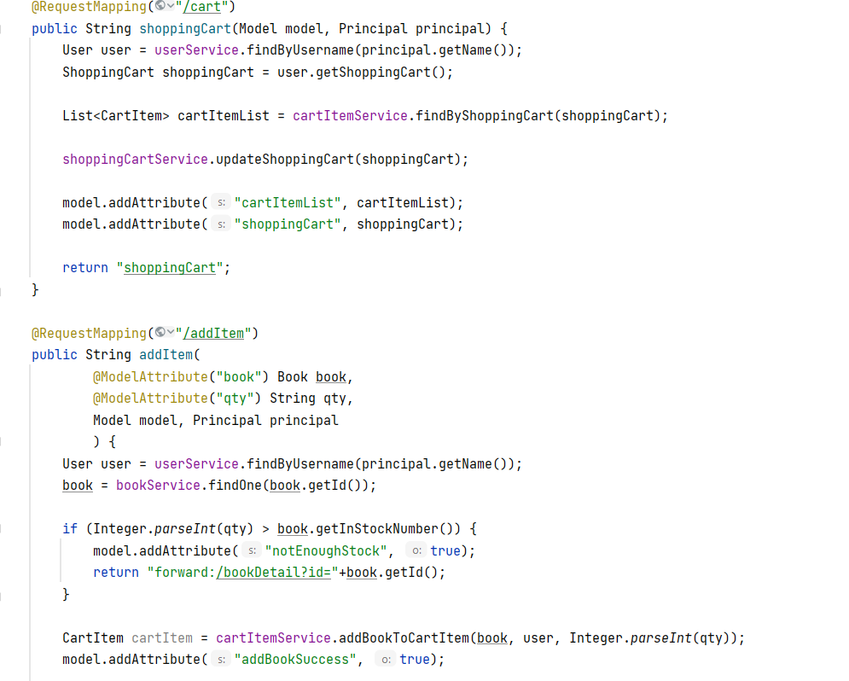
ShoppingCartController

Slide 16
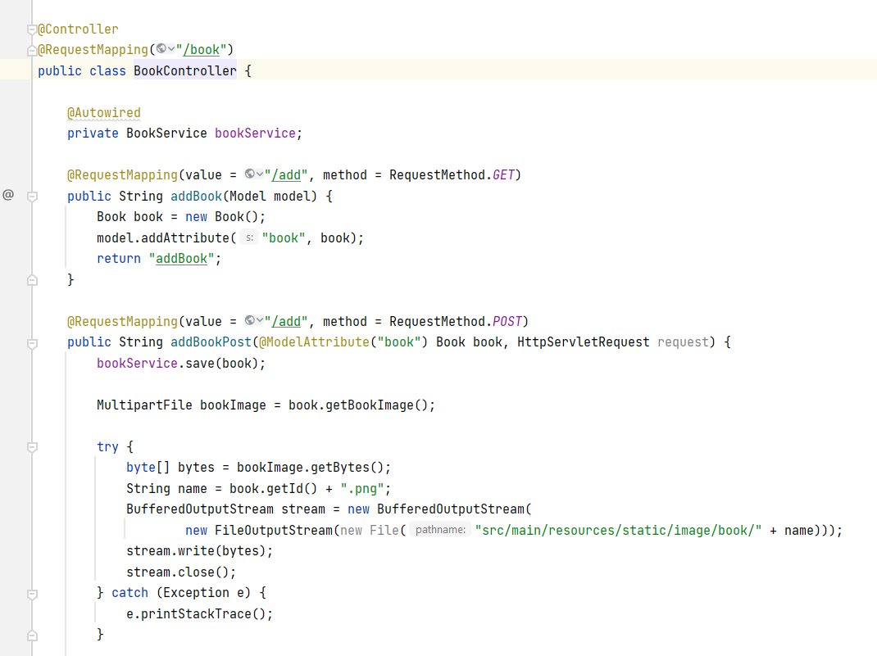
Book Controller - Admin

Slide 17
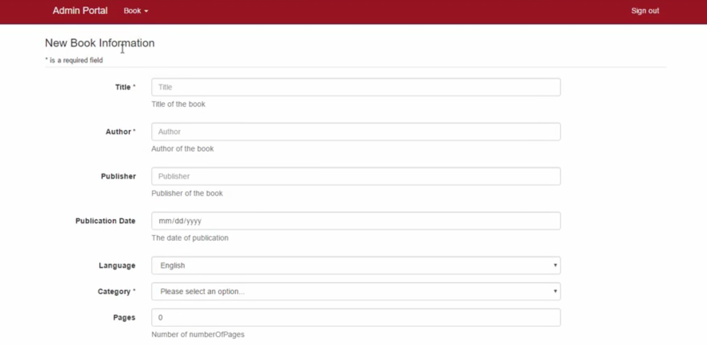
Admin Portal

Slide 18
Feature upgrades
Reporting tools and custom report features.
An integrated blog or articles section.
FAQ page
Login through facebook , google mail etc.

